Slide 1
LAW 21474 Financial Accounting
Session 2

Slide 2
Today
Using the Accounting Identity
Debits and Credits: What, Why and How
But first, some preliminaries

Slide 3
Recall
Three parts to accounting:
Aspirations: Show value and how it changes. Noble. Lofty purpose. Big help in creating/maintaining a civilized society.
Accounting Conventions: Aspirations meet real world, need conventions. Don’t get your hopes up too high!
Institutional Context: Aspirations meet real world, accounting is done by people in a social/economic/political context. Watch out!
Three steps in doing accounting:
Recognition (do we record anything?)
Classification (if so, what accounts are affected?)
Valuation (what numbers do we use?)

Slide 4
Use a Quantitative Structure
Impose a Quantitative Structure:
For any particular entity, record all numbers so that this identity is preserved at every point in time:
Assets - Liabilities ≡ Equities
(Usually written as Assets = Liabilities + Equities)
Steps in application (driven by conventions and context):
Recognition
Classification
Starts with definitions of assets, liabilities, equities, revenues, expenses, gains and losses
Valuation

Slide 5
Definitions
Asset
Probable future economic benefit
Owned or controlled by entity
Arising from a past transaction or event
Liability
Probable future sacrifice
Obligation of the entity
Arising from a past transaction or event
Equity
Difference between assets and liabilities

Slide 6
Accounting Involves Evidence and Predictions
Past
Future
Factual basis for predictions
Financial Benefits & Sacrifices
Evidence
Requires predictions
Balance sheet
time

Slide 7
Damage Calculation vs. Establishing Facts of case
Past
Future
Evidence
Predictions
Establish facts of case and applicable law
Some components of damages
Estimate damages such as lost opportunities
Trial
time

Slide 8
Accounting identity

Slide 9
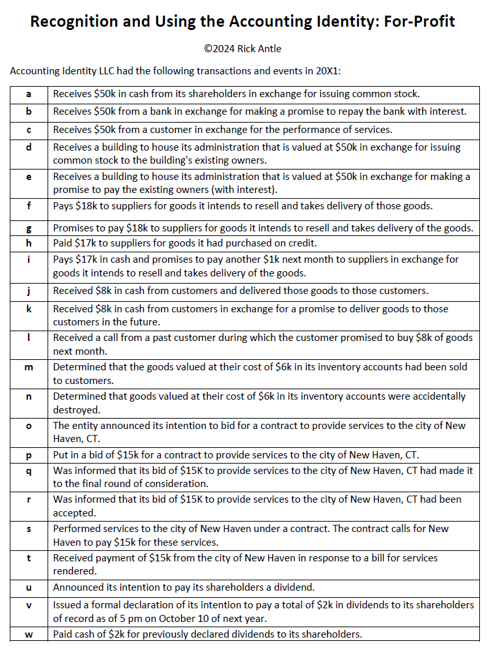

Slide 10
Debits and credits

Slide 11
Next Time
Dig into accounting
Rick and Stan’s Business
We will work through it together in class

